Slide 1
Introduction to Data Science
John P Dickerson
Lecture #24 – 11/14/2019
CMSC320
Tuesdays & Thursdays
5:00pm – 6:15pm

Slide 2
Announcements
Project 3 has been extended to next Monday, November 25!
Project 4 will be released by November 21:
The shortest project by far!
A bit of fun – visualizing and analysis geospatial data
Please make sure you’re making progress on the final tutorial!
Rubric is posted on the course webpage & on ELMS
Rubric has linked to 4-5 previous projects I liked a lot!
Please talk to me and/or the TAs whenever (many have)

Slide 3
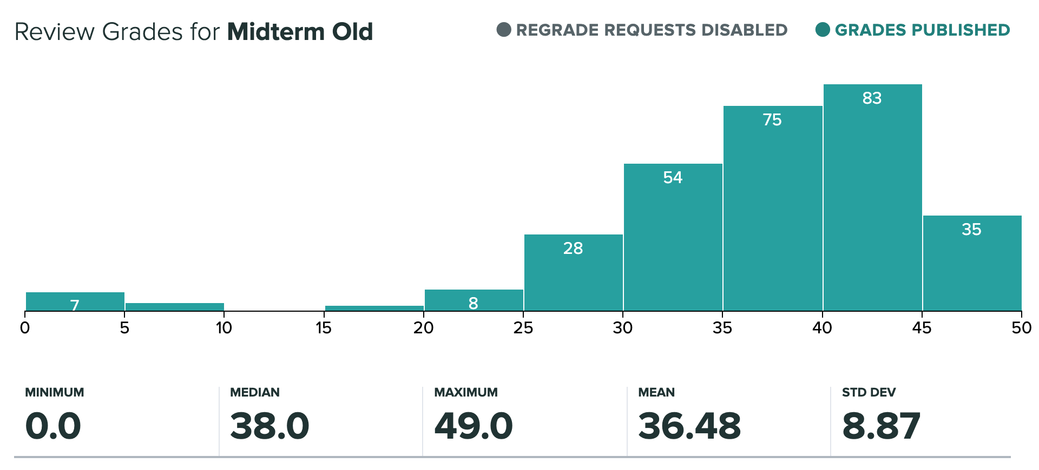
Midterm

Slide 4
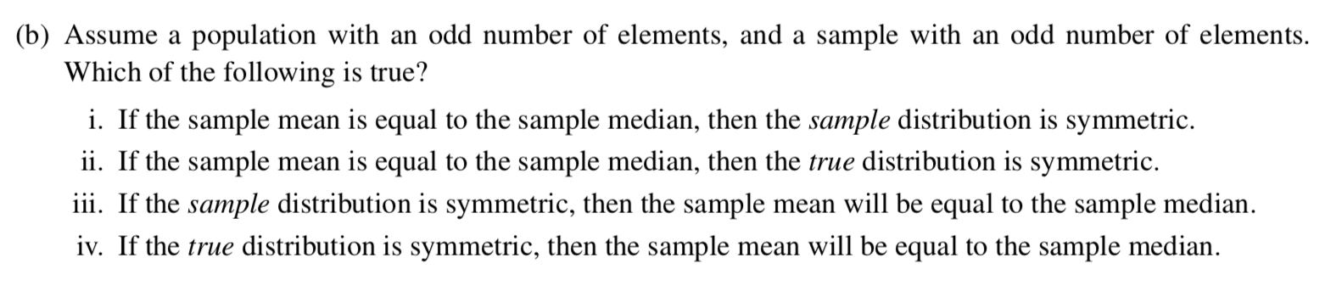
Q 2b
Counterexample to (i) ?????
(-2, -1, 0, 0, 3)
(Mean = 0, Median = 0)

Slide 5
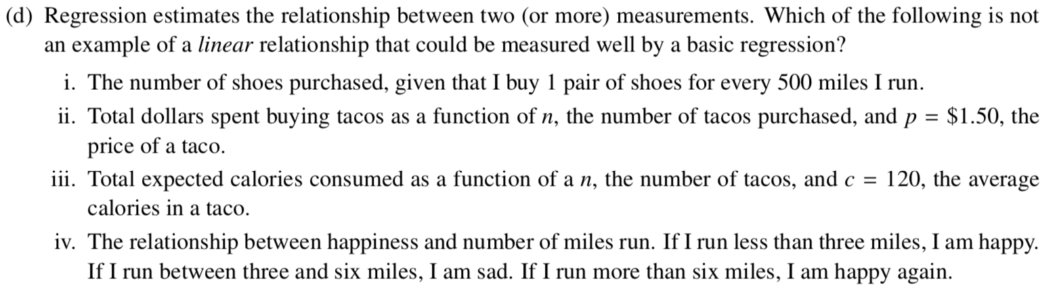
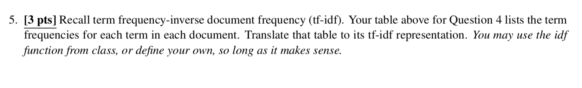
Q 2D & Q4

Slide 6
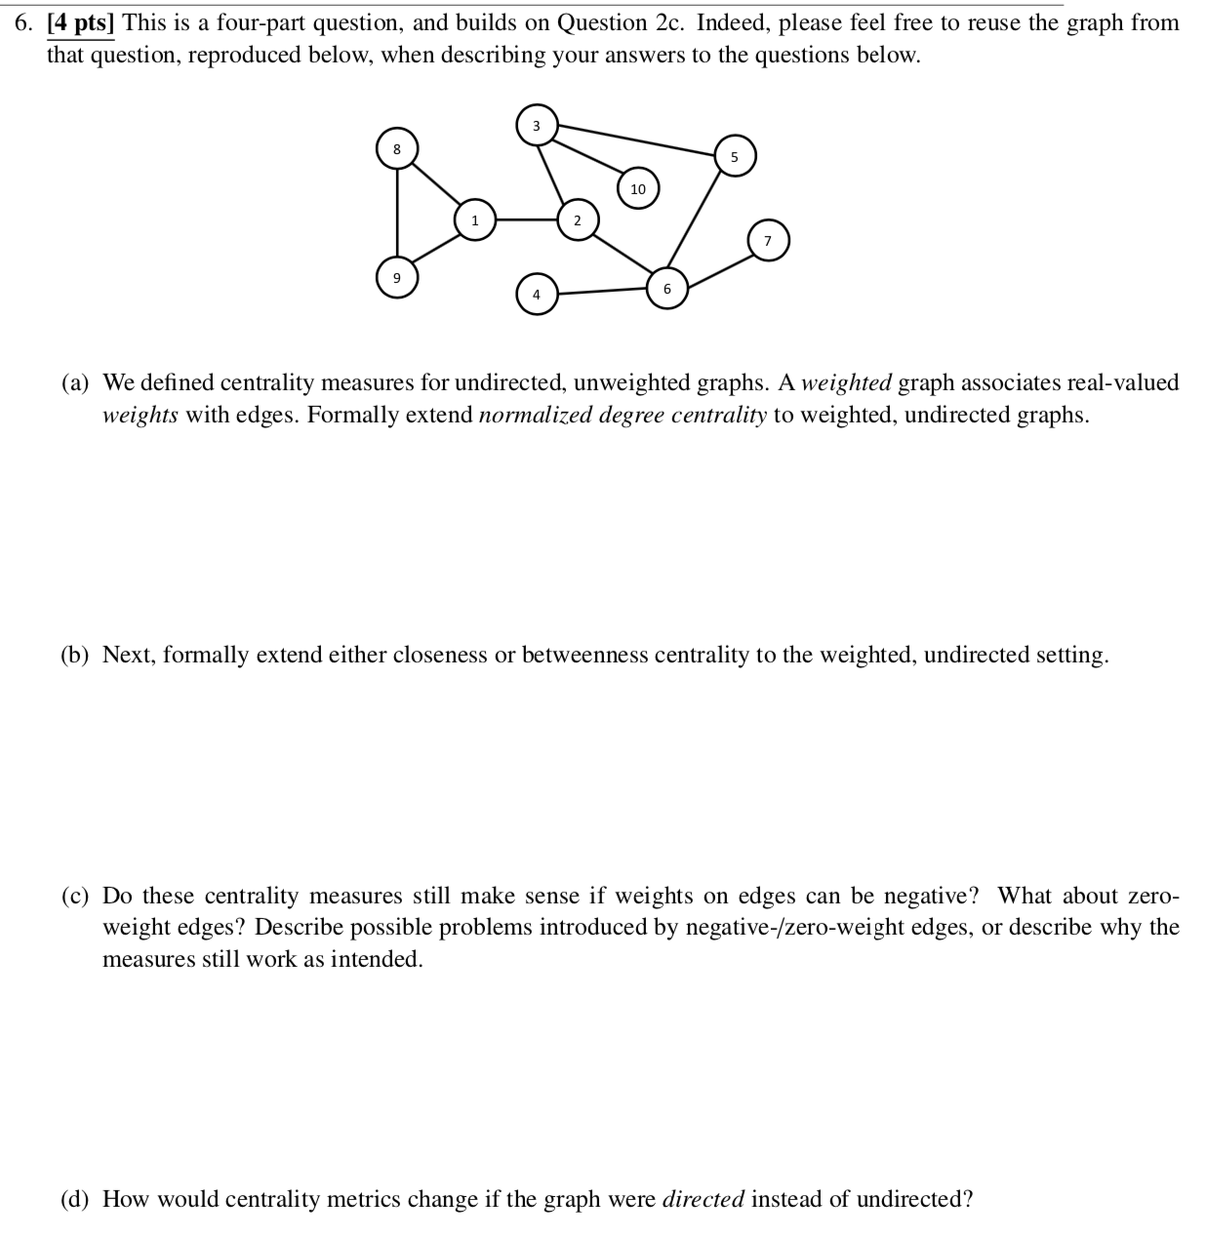
Q6 - Centrality
Weighted centrality metrics?
Negative weights?
Directed graphs?

Slide 7
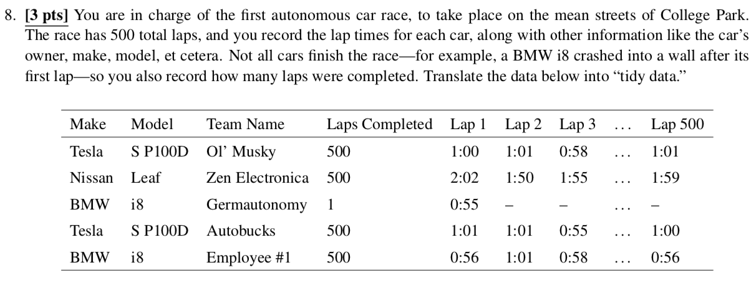
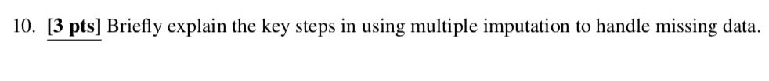
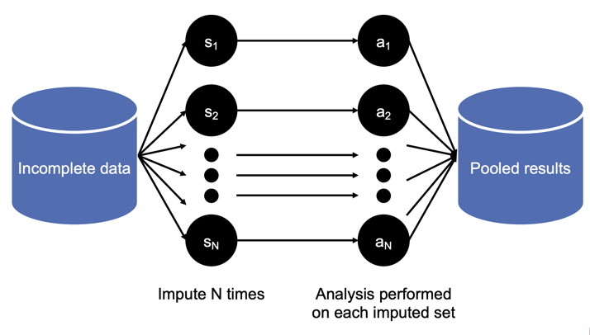
Q8 – Tidy Data & Q10 – Multiple Imputation

Slide 8
Today’s Lecture
Data collection
Data processing
Exploratory analysis
&
Data viz
Analysis, hypothesis testing, & ML
Insight & Policy Decision

Slide 9
Scaling it Up: Stochastic gradient descent (SGD)

Slide 10
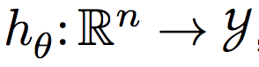
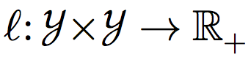
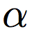
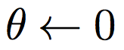
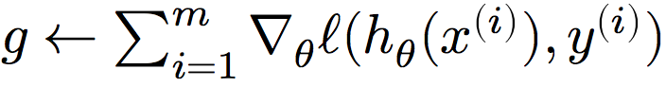
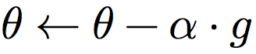
Recap: Gradient descent
Algorithm for any* hypothesis function , loss function , step size :
Initialize the parameter vector:
Repeat until satisfied (e.g., exact or approximate convergence):
Compute gradient:
Update parameters:
What if m is big?
What if n is big?
*must be reasonably well behaved

Slide 11
Stochastic gradient descent
Algorithm for any* hypothesis function , loss function , step size :
Initialize the parameter vector:
Repeat until satisfied (e.g., exact or approximate convergence):
Randomly shuffle the input set x
For i in {1, 2, … m}, shuffled:
Compute gradient:
Update parameters:
11
*must be reasonably well behaved

Slide 12
SGD continued
Can also make use of “mini-batch” stochastic gradient descent:
High-level idea: at every outer iteration, shuffle the input data, then partition into k mini-batches of size m/k
Perform inner loop of SGD on these mini-batches
Batches reduce variance in update, make use of vectorization
Issues with SGD ??????????????
Convergence: “almost surely” converges to the global optimum, assuming convexity and reasonable learning rate
Batch size: hyperparameter? Not really – figure out how many examples fit in RAM/GPU memory, then choose the nearest power of 2 and go with that
Sensitive to feature scaling (if batching over features)

Slide 13
Scaling it Up: Big Data & MapReduce
Thanks to: Jeff Dean, Sanjay Ghemawa, Zico Kolter

Slide 21
An Example Program
Present the concepts of MapReduce using the “typical example” of MR, Word Count
Input: a volume of raw text, of unspecified size (could be KB, MB, TB, it doesn’t matter!)
Output: a list of words, and their occurrence count.
(Assume that words are split correctly; ignore capitalization and punctuation.)
Example:
The doctor went to the store. =>
The, 2
Doctor, 1
Went, 1
To, 1
Store, 1

Slide 22
Map? Reduce?
Mappers read in data from the filesystem, and output (typically) modified data
Reducers collect all of the mappers output on the keys, and output (typically) reduced data
The outputted data is written to disk
All data is in terms of key-value pairs (“The” → 2)

Slide 23
MapReduce vs Hadoop
The paper is written by two researchers at Google, and describes their programming paradigm
Unless you work at Google, or use Google App Engine, you won’t use it! (And even then, you might not.)
Open Source implementation is Hadoop MapReduce
Not developed by Google
Started by Yahoo!; now part of Apache
Google’s implementation (at least the one described) is written in C++
Hadoop is written in Java

Slide 24
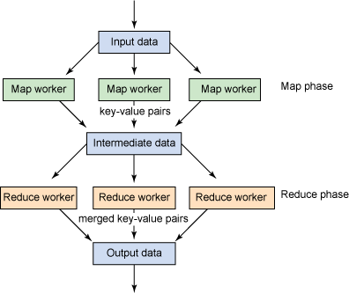
Major Components
User Components:
Mapper
Reducer
Combiner (Optional)
Partitioner (Optional) (Shuffle)
Writable(s) (Optional)
System Components:
Master
Input Splitter*
Output Committer*
* You can use your own if you really want!
Image source: http://www.ibm.com/developerworks/java/library/l-hadoop-3/index.html

Slide 25
Key Notes
Mappers and Reducers are typically single threaded and deterministic
Determinism allows for restarting of failed jobs, or speculative execution
Need to handle more data? Just add more Mappers/Reducers!
No need to handle multithreaded code
Since they’re all independent of each other, you can run (almost) arbitrary number of nodes
Mappers/Reducers run on arbitrary machines. A machine typically multiple map and reduce slots available to it, typically one per processor core
Mappers/Reducers run entirely independent of each other
In Hadoop, they run in separate JVMs
Notes:
Describing the specifics, not the reasoning behind the decisions

Slide 26
Basic Concepts
All data is represented in key-value pairs of an arbitrary type
Data is read in from a file or list of files, from distributed FS
Data is chunked based on an input split
A typical chunk is 64MB (more or less can be configured depending on your use case)
Mappers read in a chunk of data
Mappers emit (write out) a set of data, typically derived from its input
Intermediate data (the output of the mappers) is split to a number of reducers
Reducers receive each key of data, along with ALL of the values associated with it (this means each key must always be sent to the same reducer)
Essentially, <key, set<value>>
Reducers emit a set of data, typically reduced from its input which is written to disk
Notes:
Within first ~5 slides, cover the basics of Map and Reduce
Mapper takes in a set of K,V emits a new set of K,V
Intermediate data is distributed among reducers
Reducers aggregate based on key
Design decisions and justification
Be able to write pseudo code for a MR job
Understanding of what functionality they want to provide
Why did they make the decisions that they did

Slide 27
Data Flow
Split 0
Mapper 0
Input
Reducer 0
Out 0
Split 1
Mapper 1
Reducer 1
Out 1
Split 2
Mapper 2
Master
n workers
Master
Notes:
Mappers = selection; reducer = group by aggregate

Slide 28
Input Splitter
Is responsible for splitting your input into multiple chunks
These chunks are then used as input for your mappers
Splits on logical boundaries. The default is 64MB per chunk
Depending on what you’re doing, 64MB might be a LOT of data! You can change it
Typically, you can just use one of the built in splitters, unless you are reading in a specially formatted file
Notes:
Why?
Example for a text input splitter

Slide 29
Mapper
Reads in input pair <K,V> (a section as split by the input splitter)
Outputs a pair <K’, V’>
Ex. For our Word Count example, with the following input: “The teacher went to the store. The store was closed; the store opens in the morning. The store opens at 9am.”
The output would be:
<The, 1> <teacher, 1> <went, 1> <to, 1> <the, 1> <store, 1> <the, 1> <store, 1> <was, 1> <closed, 1> <the, 1> <store, 1> <opens, 1> <in, 1> <the, 1> <morning, 1> <the 1> <store, 1> <opens, 1> <at, 1> <9am, 1>

Slide 30
Reducer
Accepts the Mapper output, and collects values on the key
All inputs with the same key must go to the same reducer!
Input is typically sorted, output is output exactly as is
For our example, the reducer input would be:
<The, 1> <teacher, 1> <went, 1> <to, 1> <the, 1> <store, 1> <the, 1> <store, 1> <was, 1> <closed, 1> <the, 1> <store, 1> <opens, 1> <in, 1> <the, 1> <morning, 1> <the 1> <store, 1> <opens, 1> <at, 1> <9am, 1>
The output would be:
<The, 6> <teacher, 1> <went, 1> <to, 1> <store, 3> <was, 1> <closed, 1> <opens, 1> <morning, 1> <at, 1> <9am, 1>

Slide 31
Combiner
Essentially an intermediate reducer
Is optional
Reduces output from each mapper, reducing bandwidth and sorting
Cannot change the type of its input
Input types must be the same as output types
Notes:
Example equiv to

Slide 32
Output Committer
Is responsible for taking the reduce output, and committing it to a file
Typically, this committer needs a corresponding input splitter (so that another job can read the input)
Again, usually built in splitters are good enough, unless you need to output a special kind of file

Slide 33
Partitioner (Shuffler)
Decides which pairs are sent to which reducer
Default is simply:
Key.hashCode() % numOfReducers
User can override to:
Provide (more) uniform distribution of load between reducers
Some values might need to be sent to the same reducer
Ex. To compute the relative frequency of a pair of words <W1, W2> you would need to make sure all of word W1 are sent to the same reducer
Binning of results

Slide 34
Master
Responsible for scheduling & managing jobs
Scheduled computation should be close to the data if possible
Bandwidth is expensive! (and slow)
This relies on a Distributed File System (e.g. GFS)!
If a task fails to report progress (such as reading input, writing output, etc), crashes, the machine goes down, etc, it is assumed to be stuck, and is killed, and the step is re-launched (with the same input)
The Master is handled by the framework, no user code is necessary
Notes:
HDFS will replicate data if necessary to be local
Mention why determinism is required
Mention speculative execution

Slide 35
Mapreduce in python
def mapreduce_execute(data, mapper, reducer):
values = map(mapper, data)
groups = {}
for items in values:
for k,v in items:
if k not in groups:
groups[k] = [v]
else:
groups[k].append(v)
output = [reducer(k,v) for k,v in groups.items()]
return output

Slide 36
Mapreduce in python
Don’t do the last slide …
Python’s mrjob library:
write mappers and reducers in Python
Deploy on Hadoop systems, Amazon Elastic MR, Google Cloud
from mrjob.job import MRJob
class WordOccurrenceCount(MRJob):
def mapper(self, _, line):
for word in line.split(" "):
yield word, 1
def reducer(self, key, values):
yield key, sum(values)

Slide 37
Mapreduce?
Good:
All you need to do is write a mapper and a reducer
Can get away with not exposing any of the internals (data splitting, locality issues, redundancy, etc) if you’re using a ready-made engine
Bad:
Lots of reading/writing from disk (in part because this helps with redundancy)
Sometimes communication between processes is necessary
Talk about later: parameter servers, GraphLab aka Dato, etc

Slide 38
Next Up: Review of Hypothesis Testing (and then a bunch of stuff like Privacy, Ethics, Debugging Data Science, Etc!)

